Slide 1
RNN & LSTM
….Neural Network Architectures for Sequential Data Processing....

Slide 2
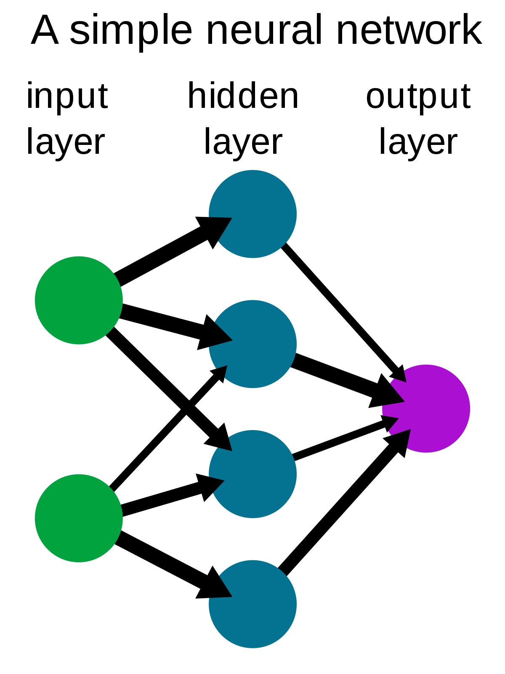
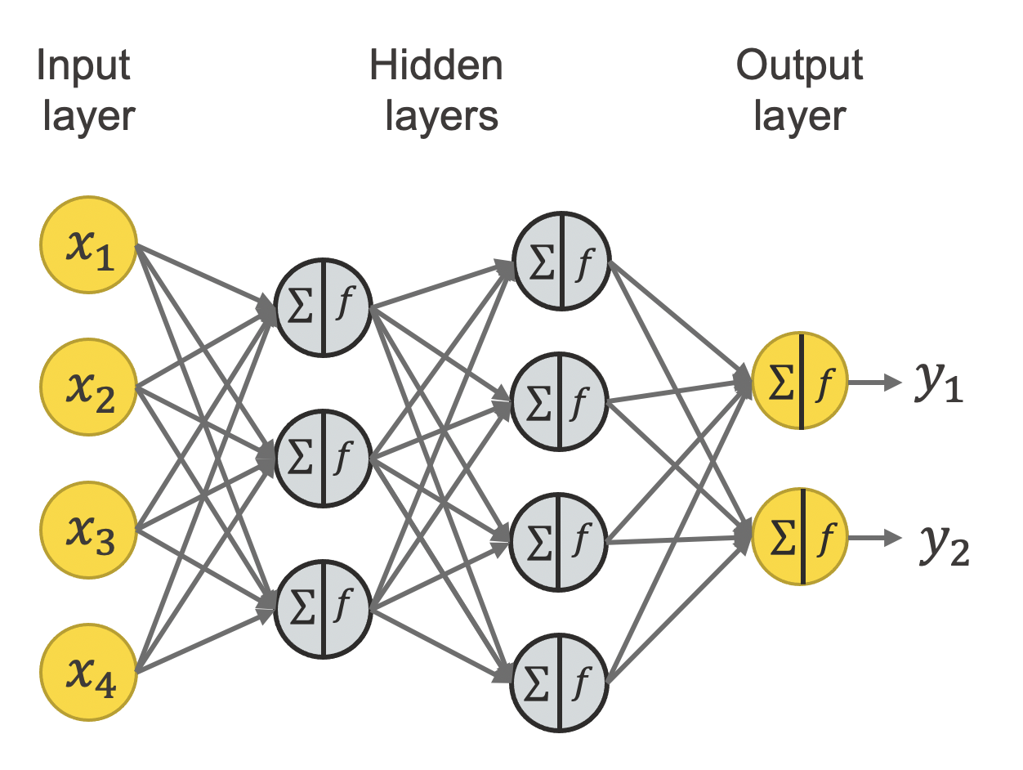
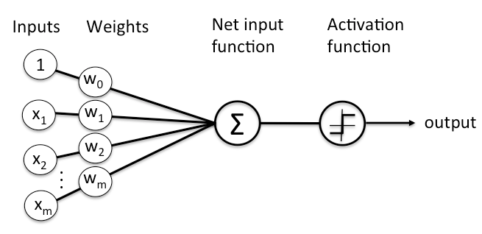
What is a neural network?
Artificial neural networks (ANN), more commonly referred to as neural networks (NN), are computing systems inspired by the biological neural networks that constitute human brains.
Neural networks are a set of algorithms, modeled loosely after the human brain, that are designed to recognize patterns. The patterns they recognize are numerical, contained in vectors, into which all real-world data, be it images, sound, text or time series, must be translated.
Deep Neural Network
Here’s a diagram of what one node might look like.

Slide 3
How Neural Networks Function Similar to The Human Brain
An artificial neural network in its most basic form has three layers of neurons. Information flows from one to the next, just as it does in the human brain:
The input layer: the data’s entry point into the system
The hidden layer: where the information gets processed
The output layer: where the system decides how to proceed based on the data
More complex artificial neural networks will have multiple layers, some hidden.
The neural network functions via a collection of nodes or connected units, just like artificial neurons. These nodes loosely model the neuron network in the animal brain. Just like its biological counterpart, an artificial neuron receives a signal in the form of a stimulus, processes it, and signals other neurons connected to it.

Slide 4
The Neuronal Workings Of An Artificial Neural Network
In an artificial neural network, the artificial neuron receives a stimulus in the form of a signal that is a real number. Then:
The output of each neuron is computed by a function of the sum of its inputs.
The connections among the neurons are called edges.
The edges have a weight. This parameter adjusts and changes as the learning proceeds.
The weight increases or decreases the strength of the signal at a connection.
Neurons may have a threshold. A signal is sent onward only if the aggregate signal crosses this threshold.
These ANNs are also called Feedforward Neural networks because they process the input in a forward direction.

Slide 5
Challenges with FFNs
ANNs can be used to process:
Numerical data
Image data
Text Data
Image classification can be solved with ANN i.e, by converting 2D images into 1D vectors before the training process. The drawback of converting 2D images into ID vectors is that the image can lose spatial features, i.e, the arrangement of pixels.
ANN cannot be used for sequential data as it cannot capture useful information in the sequential data. They can process the data only in a forward direction. In the case of sequential processing, the current output depends not only on the current input but also on the previous input/output. So there should be a mechanism to retain the previous input/output. This lacks in the FFN.
- FFN Cannot handle sequential data
- FFN Considers only the current input
- FFN Cannot memorize previous inputs

Slide 6
Different types of neural network
Feed-Forward Neural Network: Suitable for processing numerical data, Used for general Regression and Classification problems.
Convolutional Neural Network: Used for object detection and image classification.
RNN: Used for speech recognition, voice recognition, time series prediction, and natural language processing.

Slide 7
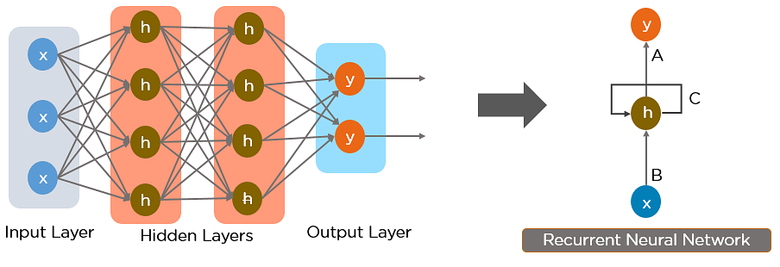
What Is a Recurrent Neural Network (RNN)?
RNN works on the principle of saving the output of a particular layer and feeding this back to the input in order to predict the output of the layer.
A neural network that uses recurrent computation for generating output is called a recurrent neural network (RNN).
This figure showshow you can convert a Feed-Forward Neural Network into a Recurrent Neural Network.

Slide 8
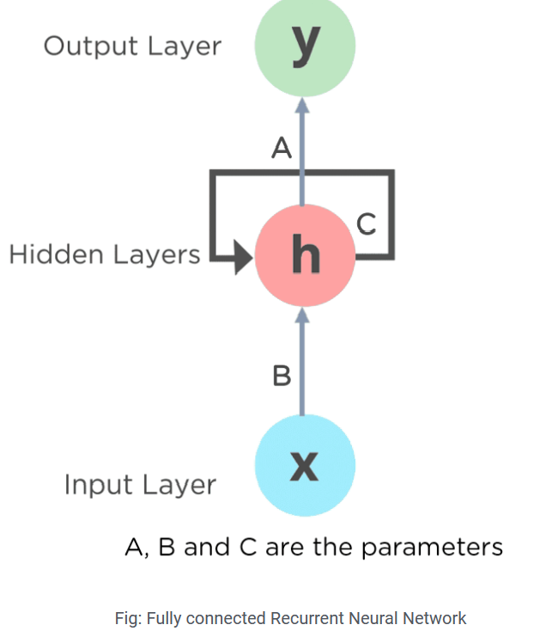
RNN
Here, “x” is the input layer, “h” is the hidden layer, and “y” is the output layer. A, B, and C are the network parameters used to improve the output of the model. At any given time t, the current output depends on the input at x(t) and x(t-1).

Slide 9
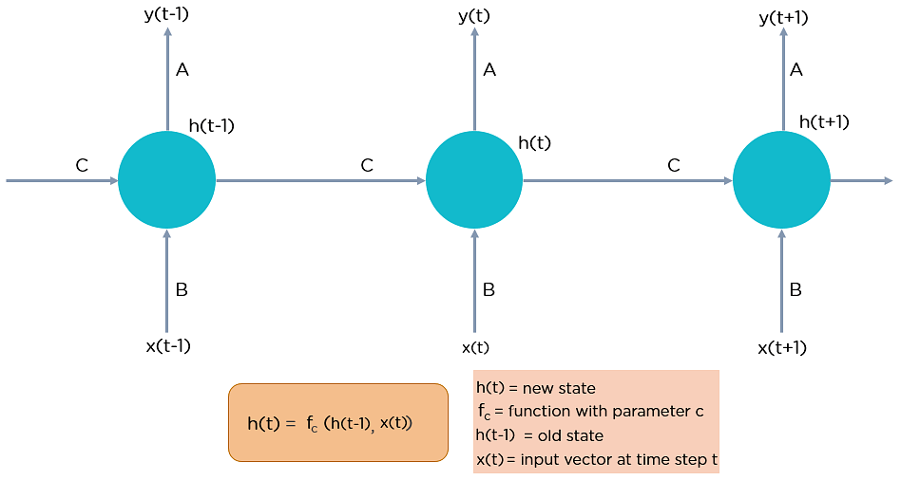

Slide 10

How Does Recurrent Neural Networks Work?
In Recurrent Neural networks, the information cycles through a loop to the middle hidden layer.
So, How,does an RNN keeps track of previous input?
- It is with the hidden states.

Slide 11
'Hidden State' of An RNN
The hidden state of an RNN means historical information of the sequence up to the current time step.
Consider an example : Suppose our task is to predict the fifth letter in the word 'HELLO'. The letter “h” has nothing preceding it, let’s take the letter “e”. So at the time the letter “e” is supplied to the network, a recurrence formula is applied to the letter “e” and the previous state which is the letter “h”. These are known as various time steps of the input. So if at time t, the input is “e”, at time t-1, the input was “h”. The recurrence formula is applied to e and h both , and we get a new state.
h_{t} = f(h_{t-1},x_{t})
h_{t} : State at time step t
h_{t-1} : State at time step t-1

Slide 12
'Hidden State' and Outputof An RNN
h_{t} = f(h_{t-1},x_{t})
Actually ht is generated by the hidden layer neurons. Suppose the activation function of hidden layer is tanh, then ht is:
h_{t} = tanh(W_{hh}h_{t-1} + W_{hx}x_{t})
W_{hh} : the weight at the recurrent neuron
W_{hx} : the weight at the input neuron is
Now, once the current state is calculated we can calculate the output state as
O_{t} = W_{oh}h_{t}
W_{oh} : the weight at the output neuron

Slide 13
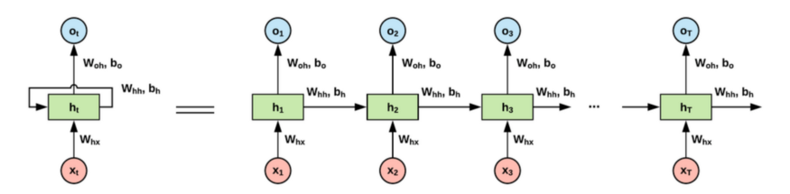

Slide 14
Steps in a RNN
A single time step of the input is supplied to the network i.e. x_{t} is supplied to the network
We then calculate its current state using a combination of the current input and the previous state i.e. we calculate h_{t}
The current h_{t} becomes h_{t-1} for the next time step
We can go as many time steps as the problem demands and combine the information from all the previous states
Once all the time steps are completed the final current state is used to calculate the output o_{t}.
The output is then compared to the actual output and the error is generated .
The error is then backpropagated to the network to update the weights and the network is trained.

Slide 15
An Example : Character Prediction Task
Lets see an example to understand how RNN is working....
Objective : Predict the next character in a word Input : A character in a word (eg : H in 'HELLO') Output : Next character (eg : E )

Slide 16
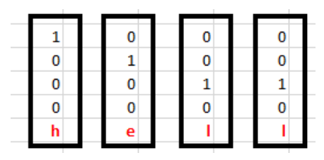
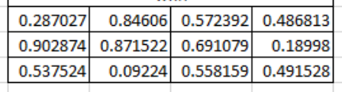
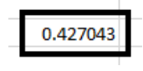
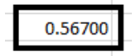
An Example : Character Prediction Task
One-hot encoded vectors
W_{hx} :
W_{hh :}
b_{h} :
Suppose we are trying to predict the characters in the word 'HELLO' . ​
Our vocabulary : {H,E,L,O}​
The inputs are one hot encoded​ .
Example RNN Architecture
3 layers: Input layer with 4 neurons
One hidden Layer with 3 neurons
Output layer with 4 neurons
Input layer weight matrix, W_{hx}
Hidden layer weight matrix and bias ,W_{hh} and b_{h}
Output layer weight matrix, W_{oh}

Slide 17
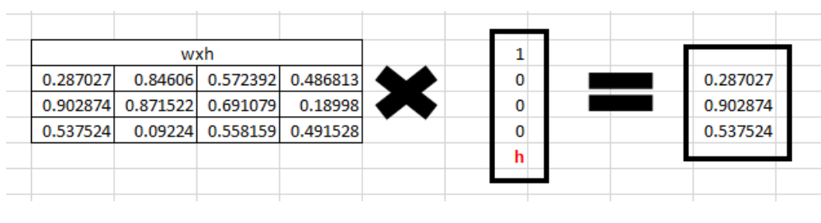
An Example : Character Prediction Task
Step 1: Now input the letter “h”, for the the hidden state we would need W_{hx}*X_{t}. By matrix multiplication, we get it as –

Slide 18
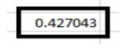
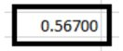
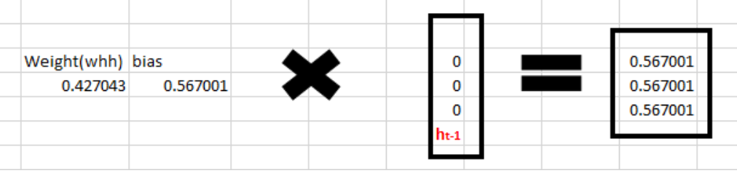
An Example : Character Prediction Task
Step 2:
Now moving to the recurrent neuron, we have Whh as the weight which is a 1*1 matrix and the bias which is also a 1*1 matrix
W_{hh}: b_{h} :
For the letter “h”, the previous state is [0,0,0] since there is no letter prior to it.
So to calculate -> (w_{hh}*h_{t-1}+ bias)

Slide 19
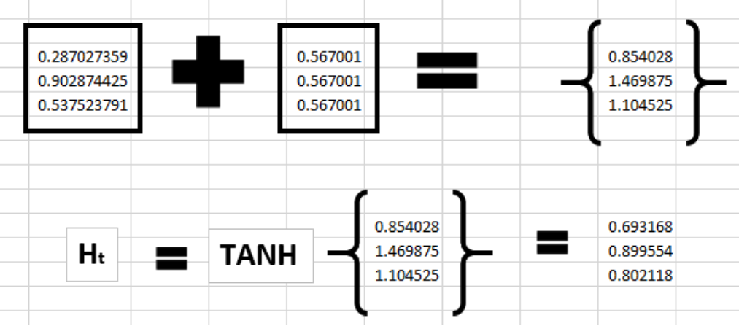
An Example : Character Prediction Task
Step 3:
Now we can get the current state as –
h_{t} = tanh(W_{hh}h_{t-1} + W_{hx}X_{t})

Slide 20
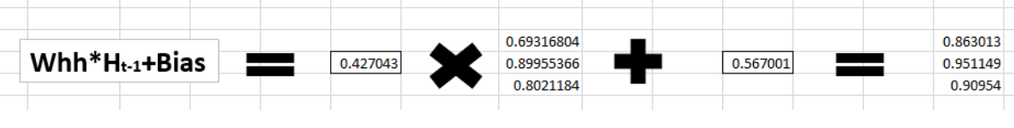
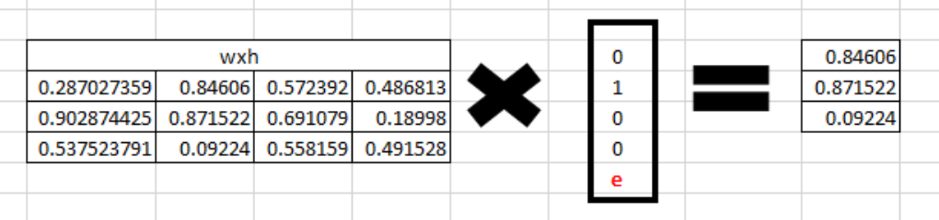
An Example : Character Prediction Task
Step 4: Now we go on to the next state. “e” is now supplied to the network. The processed output of ht, now becomes ht-1, while the one hot encoded e, is xt. Let’s now calculate the current state h_{t}, h_{t} = tanh(W_{hh}h_{t-1} + W_{hx}X_{t})
W_{hx}X_{t} :

Slide 21
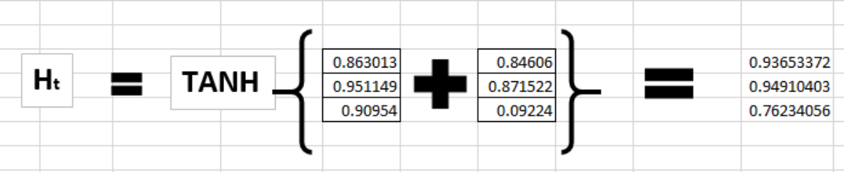
An Example : Character Prediction Task
Step 5: Now calculating ht for the letter “e”,
Now this would become ht-1 for the next state and the recurrent neuron would use this along with the new character to predict the next one.

Slide 22
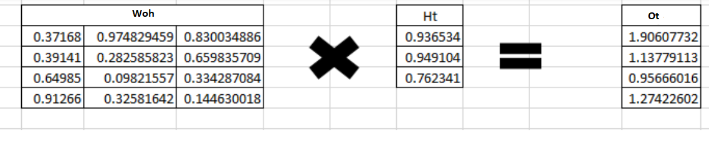
An Example : Character Prediction Task
Step 6 : At each state, the recurrent neural network would produce the output as well. Let’s calculate y_{t} for the letter e.
O_{t} = W_{oh}h_{t}

Slide 23
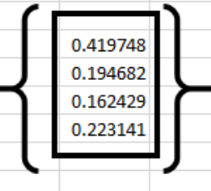
An Example : Character Prediction Task
Step 7: The probability for a particular letter from the vocabulary can be calculated by applying the softmax function. so we shall have softmax(O_{t}) .
softmax(O_{t}) =
If we convert these probabilities to understand the prediction, we see that the model says that the letter after “e” should be h, since the highest probability is for the letter “h” ie 0.419748.
We know that this is wrong. This is because we have hardly trained the network. We have just shown it two letters. So it pretty much hasn’t learnt anything yet.
We have to train the network till we are reducing the error to a tolerable level. Then , we will get the correct output.

Slide 24
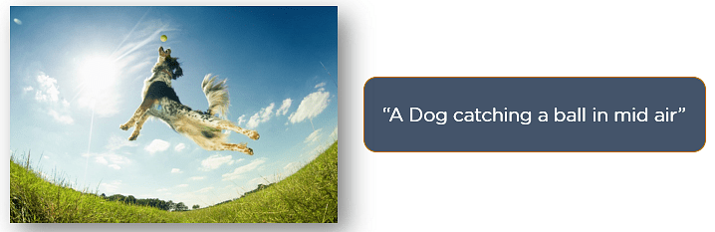
Applications of Recurrent Neural Networks
Image Captioning : RNNs are used to caption an image by analyzing the activities present.
Time Series Prediction : Any time series problem, like predicting the prices of stocks in a particular month, can be solved using an RNN.
Natural Language Processing : Text mining and Sentiment analysis can be carried out using an RNN for Natural Language Processing (NLP).
Machine Translation : Given an input in one language, RNNs can be used to translate the input into different languages as output.

Slide 25
Types of Recurrent Neural Networks
There are four types of Recurrent Neural Networks:
One to One
One to Many
Many to One
Many to Many

Slide 26
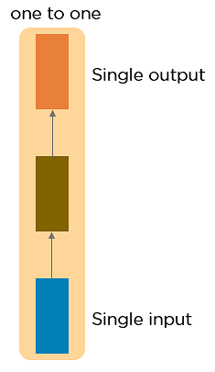
One to One RNN
This type of neural network is known as the Vanilla Neural Network. It's used for general machine learning problems, which has a single input and a single output.

Slide 27
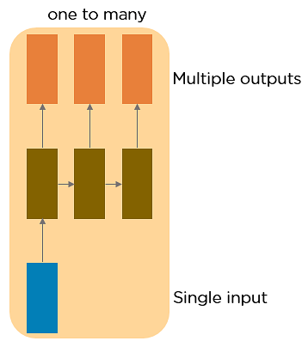
One to Many RNN
This type of neural network has a single input and multiple outputs. An example of this is the image caption.

Slide 28
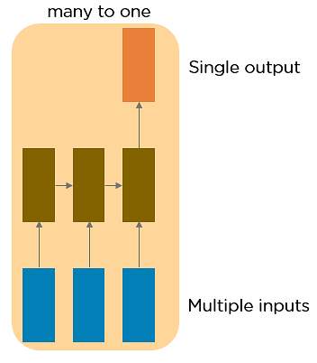
Many to One RNN
This RNN takes a sequence of inputs and generates a single output. Sentiment analysis is a good example of this kind of network where a given sentence can be classified as expressing positive or negative sentiments.

Slide 29
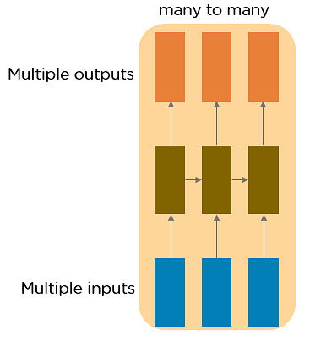
Many to Many RNN
This RNN takes a sequence of inputs and generates a sequence of outputs. Machine translation is one of the examples.

Slide 30
Two Issues of Standard RNNs
1. Vanishing Gradient Problem
The gradients carry information used in the RNN, and when the gradient becomes too small, the parameter updates become insignificant. This makes the learning of long data sequences difficult.
2. Exploding Gradient Problem
This problem arises when large error gradients accumulate, resulting in very large updates to the neural network model weights during the training process.
B'cos of vanishing/exploding gradients, RNNs are difficult to get trained with basic BPTT.

Slide 31
Shortcomings of RNN
Sometimes, we only need to look at recent information to perform the present task
Case 1: “The clouds are in the sky,” - The gap between the relevant information and the place that it’s needed is small, RNNs can learn to use the past information.
No further context is needed.
Case 2: “I grew up in France… I speak fluent French” - The gap between the relevant information and the point where it is needed becomes very large.
Then, RNNs become unable to learn to connect the information.
Thankfully, LSTMs don’t have this problem!
Now, let’s discuss the most popular and efficient way to deal with gradient problems, i.e., Long Short-Term Memory Network (LSTMs).

Slide 32
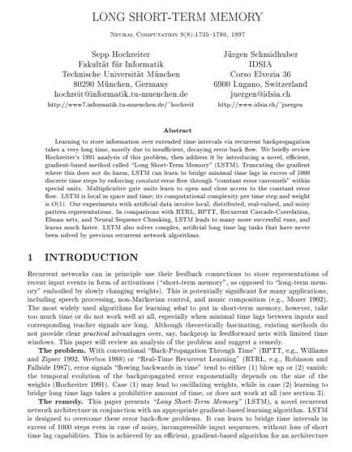
Long Short Term Memory
LSTMs are introduced by Hochreiter & Schmidhuber (1997)

Slide 33

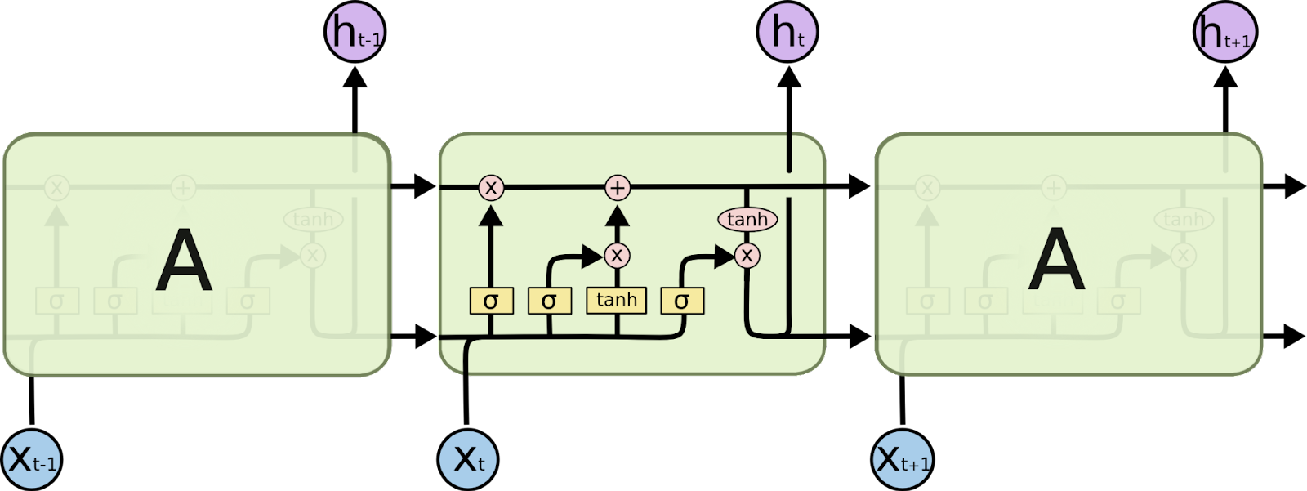

Architectural difference - RNN & LSTM
The repeating module in a standard RNN contains a single layer
The repeating module in an LSTM contains four interacting layers.

Slide 34
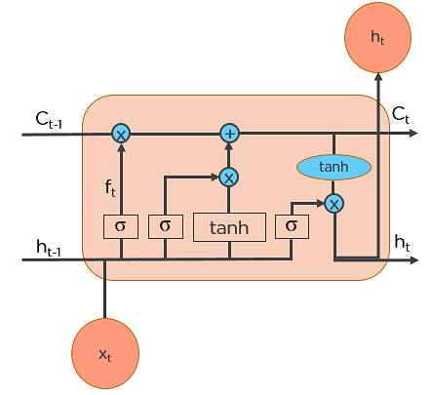
Workings of LSTMs

Slide 35
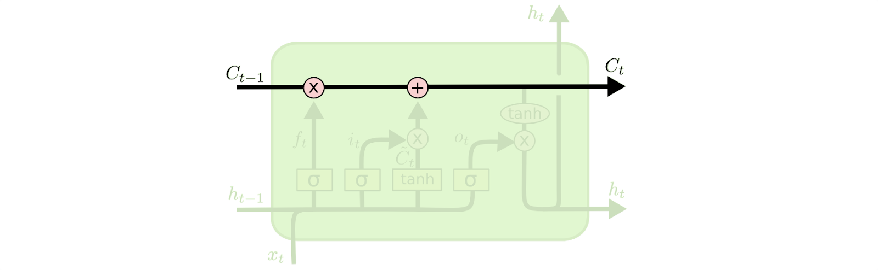
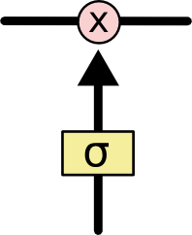
LSTM-Closer View
The key to LSTMs is the cell state, the horizontal line running through the top of the diagram
LSTM has the ability to remove or add information to the cell state, carefully regulated by structures called gates.
Gates are a way to optionally let information through - composed out of a sigmoid neural net layer and a pointwise multiplication operation
The sigmoid layer outputs numbers between zero and one, describing how much of each component should be let through.
A value of zero means “let nothing through,” while a value of one means “let everything through!”.
An LSTM has three of these gates, to protect and control the cell state.
Cell State
Gate

Slide 36
LSTM Walk Through
Decide what information we’re going to throw away from the cell state. This decision is made by a sigmoid layer called the “forget gate layer”.
Decide what new information we’re going to store in the cell state.
First, a sigmoid layer called the “input gate layer” decides which values we’ll update.
Next, a tanh layer creates a vector of new candidate values, that could be added to the state. In the next step, we’ll combine these two to create an update to the state.
Update the old cell state, into the new cell state
Finally, decide what we’re going to output
Run a sigmoid layer which decides what parts of the cell state we’re going to output.
Put the cell state through tanh and multiply it by the output of the sigmoid gate, so that we only output the parts we decided to.

Slide 37
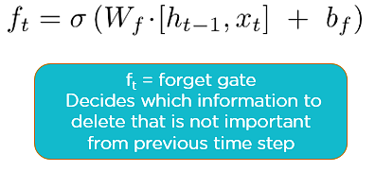
LSTMs work in a 3-step process : 1. Forget Gate
Step 1: Decide How Much Past Data It Should Remember
The first step in the LSTM is to decide which information should be omitted from the cell in that particular time step. The sigmoid function determines this. It looks at the previous state (ht-1) along with the current input xt and computes the function.

Slide 38
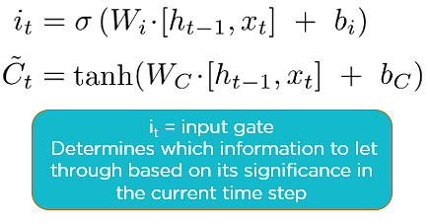
2. Input Gate
Step 2: Decide How Much This Unit Adds to the Current State
In the second layer, there are two parts. One is the sigmoid function, and the other is the tanh function. In the sigmoid function, it decides which values to let through (0 or 1). tanh function gives weightage to the values which are passed, deciding their level of importance (-1 to 1).

Slide 39
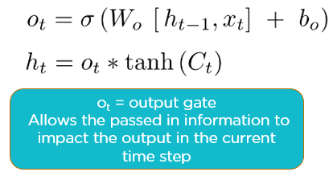
3. Output Gate
Step 3: Decide What Part of the Current Cell State Makes It to the Output
The third step is to decide what the output will be. First, we run a sigmoid layer, which decides what parts of the cell state make it to the output. Then, we put the cell state through tanh to push the values to be between -1 and 1 and multiply it by the output of the sigmoid gate.

